Slide 1


Slide 2
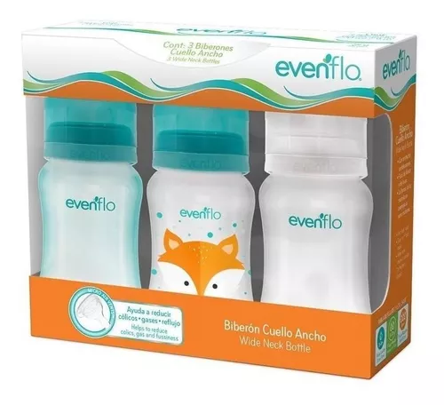
Objective of the project
Analyze the distribution channels, through the sales channels provided by the Kimberly Clark company. The main objective is to carry out an analysis of how to introduce the main products or star products (feeding bottles, training cups, nipples and bibs) through E-Commerce, since most of the products are distributed through self-service or specialized services. The goal is to ensure that the target, in this case, new mothers or those who have babies between 1 and 3 years old, can easily acquire our products.

Slide 3
Analysis of the 4 sub-segments of EVENFLO
An analysis was carried out to know the behavior of the products during the first semesters of 2021 and 2022. Within this analysis, an attempt was also made to highlight the main cities in Mexico such as CDMX, Monterry and Guadalajara.
This in order to be able to validate the channels mostly used for the commercialization of the main 4 products.

